Slide 1

Ohio Help Me Grow offers the programs, tools, and guidance to help children and families thrive.
Notes:
This presentation will share information about Ohio’s Help Me Grow program. Help Me Grow connects families to a network of information and resources so children and families can thrive!

Slide 2

Presenter’s Name
Agency name
Notes:
Introduce yourself, your role with Help Me Grow, and the agency you work for (+how it relates to Help Me Grow).

Slide 3

Why Help Me Grow?
Early experiences create the foundation for success.
Notes:
Help Me Grow understands that a child’s early experiences influence brain development and create the foundation for success. Help Me Grow promotes positive outcomes for pregnant individuals, supports child development, and empowers families.

Slide 4
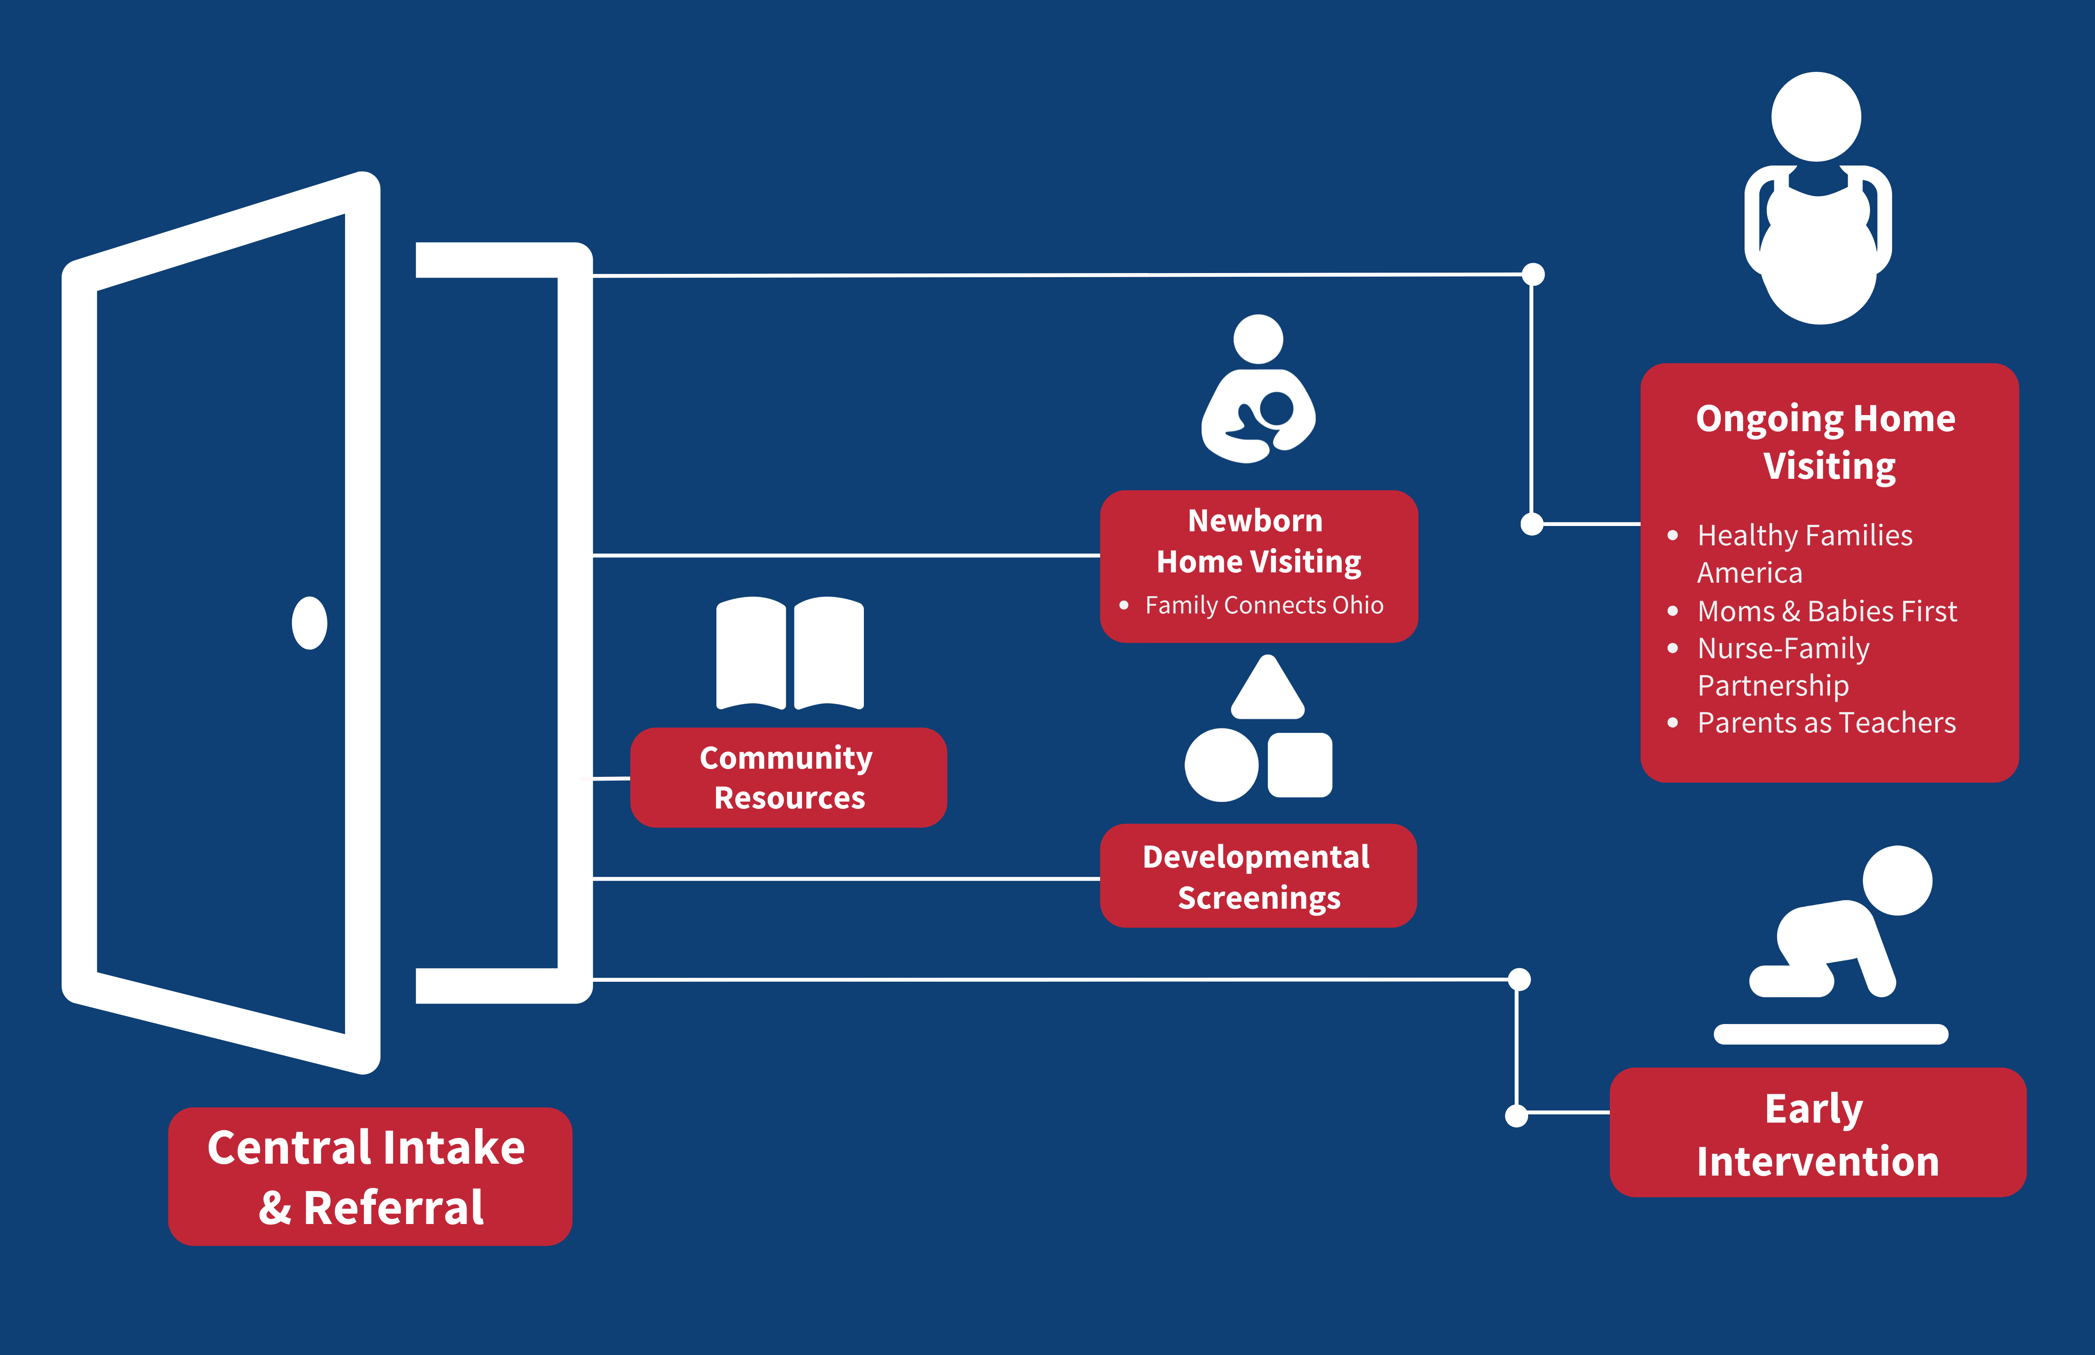

Notes:
Help Me Grow offers developmental screenings, community resources, newborn home visiting, ongoing home visiting, and early intervention services to support healthy births and give all children the best possible start in life. With Central Intake and Referral, a single point of entry makes every door the right door to services for families with young children.

Slide 5
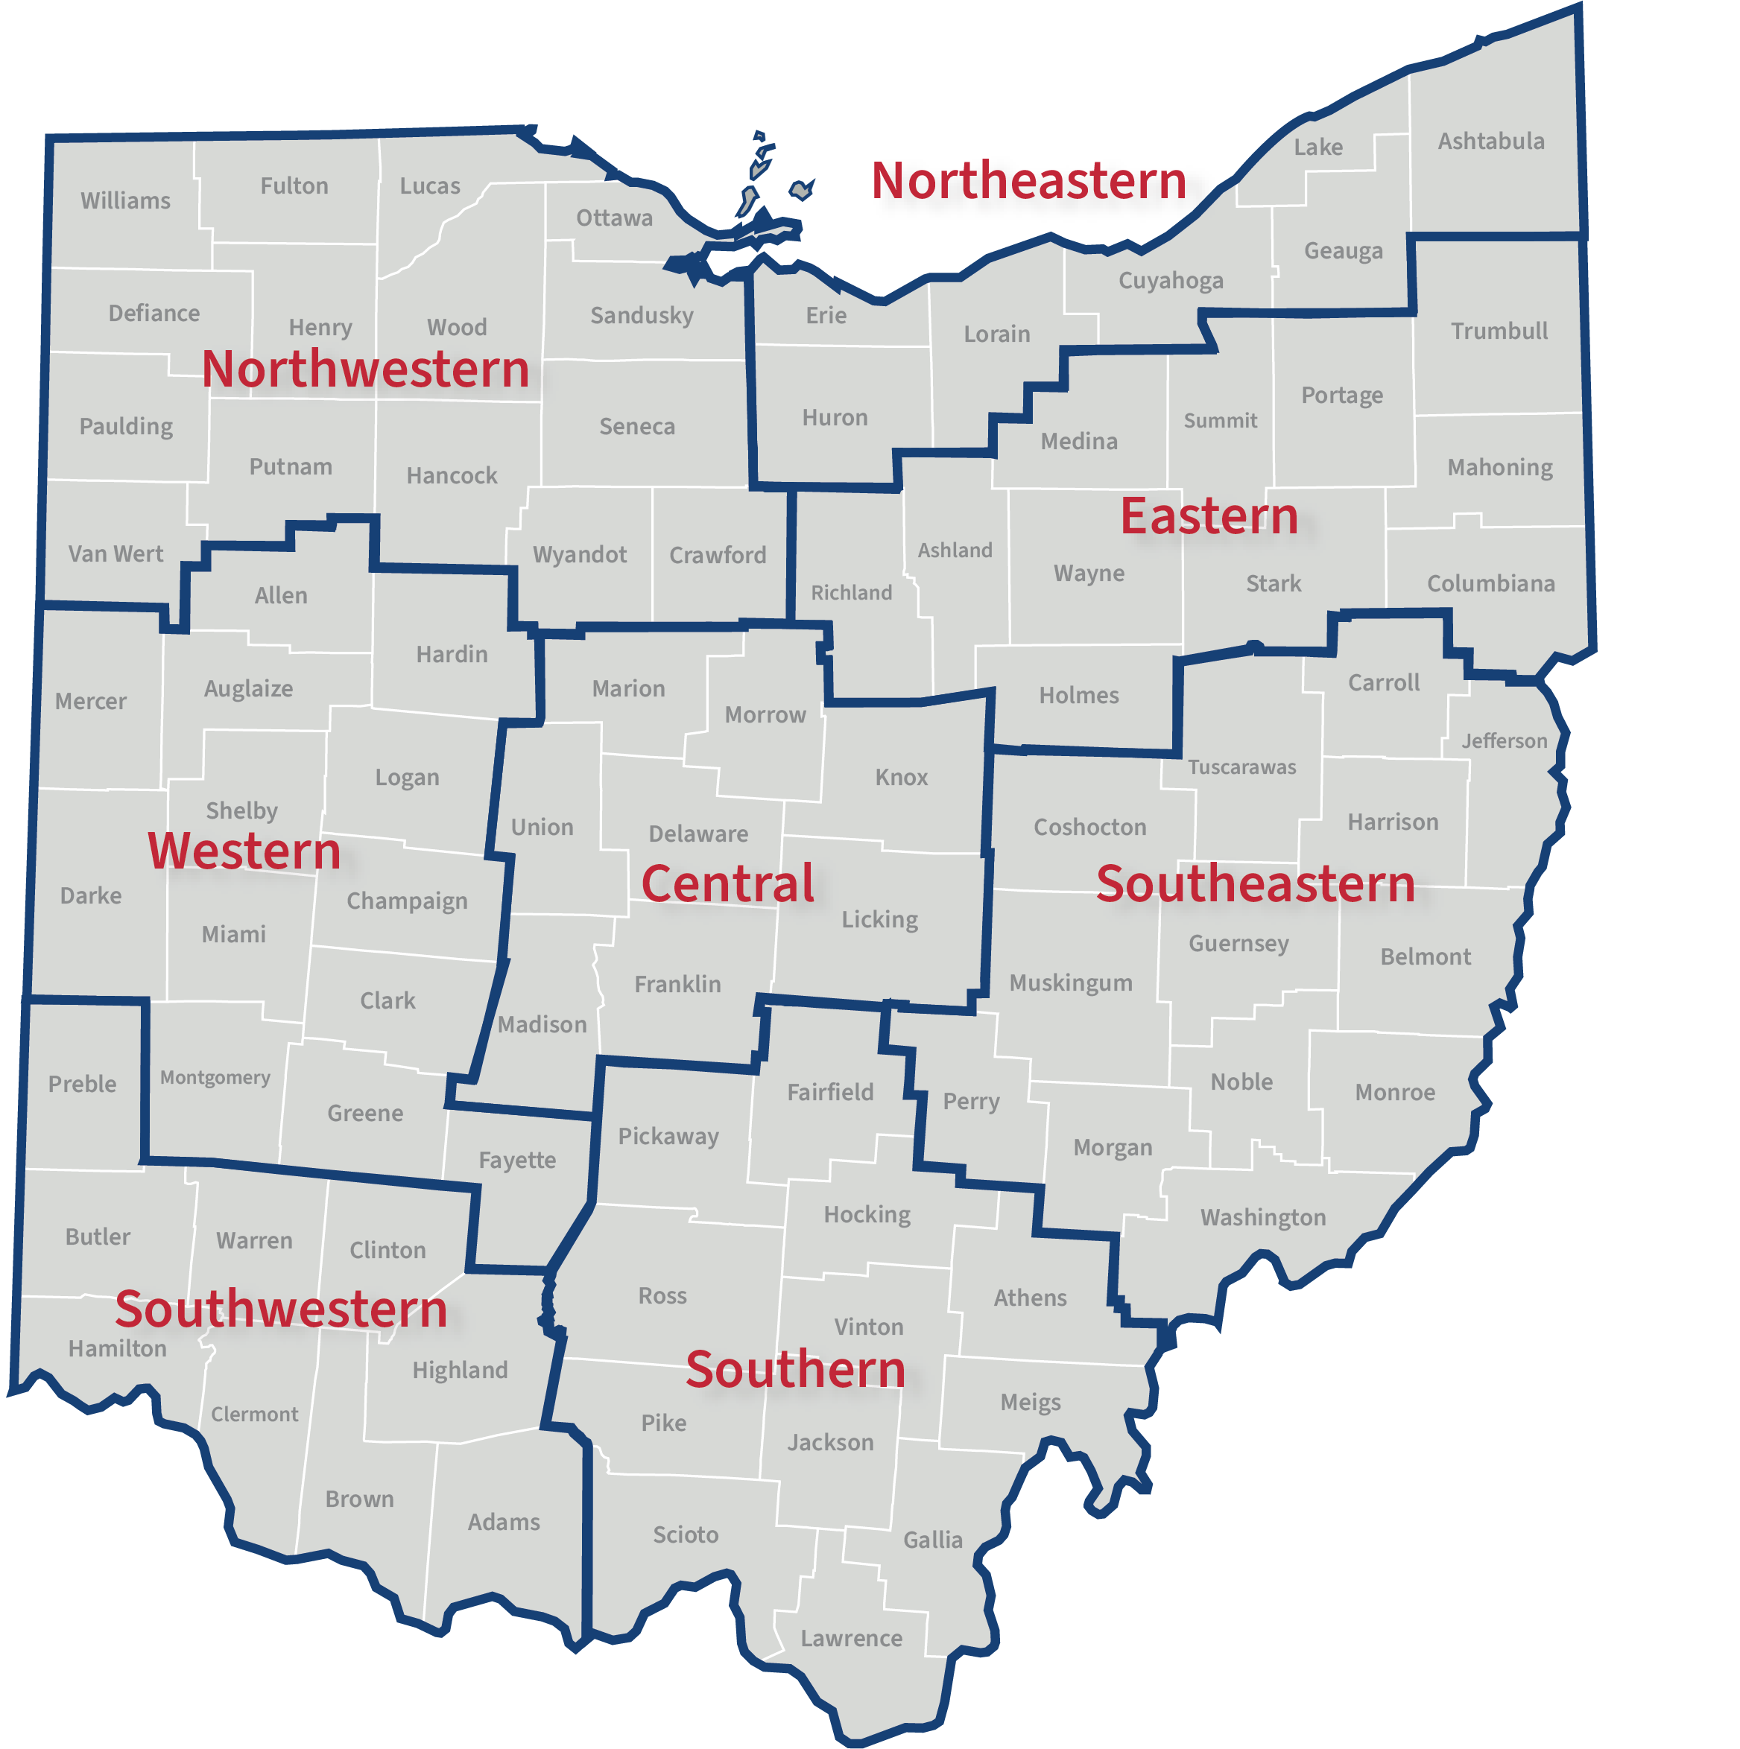
STATEWIDE REFERRAL SYSTEM
Referral Sources
Early Childhood Central Intake and Referral
System of Support
Prenatal providers
Physicians and other medical providers
Public Children Services agencies
Electronic Pregnancy Risk Assessment forms
WIC
211
Early Care and Education providers
Non-profit agencies
Early Intervention providers
Home Visiting providers
Hospital-based Child Find Specialists
Community health workers
Primary caregivers, family members, and friends
Managed care providers
Neighborhood Navigators
Early Intervention programs
Home Visiting programs
(Newborn and ongoing)
Developmental Screenings
Community Resources
Notes:
Help Me Grow Central Intake and Referral, or CIR, is a statewide system that reaches out to families, referral sources, and providers to increase quality referrals and connect families to the services and supports they need to thrive.
CIR is provided by Bright Beginnings and its statewide regional partners who develop and maintain relationships with providers, potential referral sources and other community stakeholders so that together we can support families prenatally through five years of life.
Here is a visual of our CIR model.
On the left, we have examples of our referral sources. Families and other referral sources across the state can contact a statewide phone number, fax number, web referral form, or email address to access services. They can also choose to call a local number to get connected to a specific region.
Regardless of how a family enters the program, they will get connected to the options that best meet their needs and that are available in their community. This includes Early Intervention, Home Visiting and/or other home-based programs such as Early Head Start and Healthy Start, developmental screenings, and/or other community supports such as 211, WIC, Pathways Community HUB, and more.

Slide 6

Early Intervention
Notes:
Now let’s talk about Early Intervention, which is also part of the Help Me Grow system of supports.

Slide 7

What is Early Intervention?
Early Intervention (EI) supports families of children birth to age three who have developmental delays or disabilities, so they have the best possible start in life.
EI is a partnership with families to support a child who has developmental delays or disabilities.
EI professionals support families to identify a child’s strengths and needs and address concerns as early as possible.
Notes:
Early Intervention, or EI, provides coordinated supports families of children birth to age 3 who have developmental delays or disabilities, so they have the best possible start in life.
In Ohio, the EI fulfills the federal Individuals with Disabilities Education Act, or IDEA, Part C, program requirements for infants and toddlers with disabilities.
EI is a partnership with families to support a child who has developmental delays or disabilities. EI professionals support families to identify a child’s strengths and needs and address concerns as early as possible.

Slide 8

Who should be referred to Early Intervention?
Children from birth to age three whose families are concerned about their child’s development, and children who have a medical diagnosis or developmental delay
Automatic eligibility for many diagnoses including:
  Extreme prematurity (born at <28 weeks)
  Very low birth weight (<3.3 pounds)
  NICU stay greater than 30 days
  Hearing loss
  Neonatal abstinence syndrome/neonatal opioid withdrawal syndrome
  Elevated blood lead levels
Notes:
Families whose children have a medical diagnosis affecting their development or a developmental delay, as well as families who suspect their child might have a delay, should be referred to EI.
Many diagnoses automatically qualify a family for EI services. Some example conditions include extreme prematurity, very low birth weight, NICU stay greater than 30 days, hearing loss, Neonatal Abstinence Syndrome/Neonatal Opioid Withdrawal Syndrome, or Elevated Blood Lead Levels.
With documentation from a health care professional, there are other diagnoses that can also make a child eligible for EI; however, a child does not have to have a diagnosis to be eligible for EI. If there is a concern that a child may have a delay or disability, it’s important to refer them for EI as soon as possible. Screening and eligibility determination are always free.
Once a referral is made, professionals with expertise in early development will conduct an evaluation and/or assessments to determine if a child and family are eligible for services. If so, they will support the family in addressing the child’s specific developmental, physical, social, and emotional needs.

Slide 9

The entire program worked wonderfully for our family! The therapists are amazing. They were so attentive and aware of both my sons’ needs. The exercises and practices we learned through EI have dramatically changed the quality of my children's lives, and I am so grateful.
Notes:
EI can have a powerful impact on a family’s life. This quote comes from a family about their experience. “The entire program worked wonderfully for our family. The therapists are amazing. They were so attentive and aware of both of my sons’ needs. The exercises and practices we learned through Early Intervention have dramatically changed the quality of my children’s lives, and I am so grateful.”

Slide 10

Where do Early Intervention services happen?
Services happen in the child’s home, childcare setting, or other community setting.
EI services happen side-by-side with other supports and services
EI is available in every part of the state and to any eligible child, regardless of the family’s income.
Notes:
It’s important to understand that EI services are not the same as clinical therapy. EI typically provides services in the child’s home or childcare setting, in the context of everyday routines, based on the family’s priorities. The location would be determined between the family and provider. EI services can be provided side-by-side with other services a family receives in their community.
EI is available to any eligible child in Ohio. Again, the referral and eligibility process is free and it is not based on the family’s income. Anyone child can refer a child to EI. In fact, families can self-refer their child if they have concerns. It is not necessary for a doctor or a teacher to refer a child—anyone can do it! All it takes is a simple phone call or a few moments online to fill out a short form.

Slide 11

No need to “wait and see.”
Research shows starting EI services as early as possible gives a child the best chance to learn and grow.
“Wait and see” does not provide peace of mind for a family’s concerns.
EI can address all types of concerns, such as physical development like crawling or walking, speech delays, and social interaction like playing with other children.
Notes:
When families share concerns, there is never a reason to follow with a, “Let’s wait and see if the child ‘catches’ up.” approach. Submitting a referral will provide peace of mind, knowing that EI professionals will be able to determine whether a child is eligible and support the family to address the child's specific developmental, physical, social, and emotional needs.
Every child is unique, and EI services are designed based on these specific needs. EI can address all types of concerns, such as speech delays, physical development like crawling or walking, and social interactions like playing with other children. EI service coordination can help families navigate needed services and resources. This early support can exponentially impact developmental progress and reduce the need for services later in life. Not only is it beneficial to each child and family who participate in EI services, it is more cost effective to provide EI than to wait until a child is older.
If the child is eligible for EI services, the family, their service coordinator and the EI team will develop a plan that supports the family’s journey.

Slide 12
Early Intervention can address specific delays
Behavior and social-emotional delays
Speech and communication
Movement and motor development
Diagnosed disabilities
Notes:
Families often have concerns about how a child is developing, compared to other children their age.
A child might demonstrate difficulties with behavior or playing with other children. EI can help families develop routines that support the child’s social emotional development and positive social interactions.
A child who is experiencing a speech or communication delay might not babble or talk like other children and may show signs of frustration. EI can help the family learn how to provide more opportunities to practice speech and communication.
For a child who is not crawling, rolling, or walking like their peers, EI can help the family figure out why their child's motor skills are delayed. EI can also assist the family with adapting the home environment in ways that provide more opportunities for movement.
The developmental areas shown on this slide are a sample of delays EI can address, but EI serves children with all types of delays and disabilities.

Slide 13
EaRLy Intervention Roadmap
Refer
Eligibility
Assessment
Individualized Family Service Plan (IFSP)
Service Delivery
Notes:
Throughout service delivery, your team will work closely with your family to help build your skills and confidence to support your child. As the EI journey comes to an end for your family, your team will help you make the smooth transition to your child’s next learning environment.
REFER: EI begins with a referral or self-referral. Families will receive a call to explain services and what to expect. An assigned service coordinator helps with each step in the process, and the family decides whether to move forward.
ELIGIBILITY: For some children, EI professionals determine eligibility by evaluating the child, reviewing medical reports, and talking with parents. Other children are eligible because of a diagnosed condition.
ASSESSMENT: If a child is determined eligible, an assessment team will learn more about how the child is developing. This team works to understand the family’s routines and what’s important to them.
IFSP: The team uses the information gathered to create an Individualized Family Service Plan (IFSP). It details the services needed to help your family meet the outcomes you want, along with when, where, and how these services will be provided. An IFSP will be completed within the first 45 days of referral and updated at least every six months. The plan recognizing that parents and families are the center of a child’s development.
Services must start within 30 days of you signing the IFSP.

Slide 14
Primary Service Provider Approach
YOU
Speech Language Pathologist*
Developmental Specialist*
Service Coordinator
Occupational Therapist*
Physical Therapist*
* Possible Primary Service Provider (PSP)
Notes:
If the child is eligible for EI services, the family and team, which includes their service coordinator, will develop a plan to support the family on their journey to help their child.
In Ohio, EI uses an evidence-based method called the Primary Service Provider approach. This family-centered approach allows a full team of professionals to select a provider who will take the lead in providing services. While an entire team of professionals are involved, this ‘primary’ service provider uses coaching to support and empower families so that young children can get their best possible start in life.

Slide 15
The ability for our son to engage in therapy in the comfort of his own home has been such a big help. It was great to be able to see how different therapies actually worked for us in our own home, with things that we already had.
Notes:
This quote comes from another family about their experience in EI. “The ability for our son to engage in therapy in the comfort of his own home has been such a big help. It was great to be able to see how different therapies actually worked for us in our own home, with things that we already had.”

Slide 16
Why medical teams should refer outside clinical setting
EI services are not the same as traditional clinical therapy.
  EI typically provides services in the child’s home or childcare setting, in the context of everyday routines, based on the family’s priorities.
EI services can complement medical care
EI services support parents and caregivers in understanding a child’s delay or disability
The earlier you refer, the better EI services can ONLY help a child
Notes:
EI professionals can partner with the healthcare team to support families. EI services can complement medical care.
EI services are not the same as traditional clinical therapy. Again, EI typically provides services in the child’s home or childcare setting, in the context of everyday routines, based on the family’s priorities.
EI services support parents and caregivers in understanding a child’s delay or disability. The earlier you refer, the better EI services can ONLY help a child
Communication between EI professionals and a child’s healthcare team following a referral is extremely beneficial. The responsiveness of the healthcare team can help ensure that families move forward and the process is conducted with accuracy and efficiency.

Slide 17



Complete a referral form online
at www.helpmegrow.org.
Call (800) 755-GROW (4769)
to speak with an intake specialist.
Email a completed referral form to
hmgreferrals@helpmegrow.org.
Fax completed referral forms to (855) 418-3322 or (855) 318-3322.
Get connected
or refer to
Help Me Grow services today!
Notes:
There are a variety of ways to make a referral to Help Me Grow, including visiting the helpmegrow.org website to access the secure online referral form, calling our toll-free number at (800) 755 4769 (GROW) or emailing a referral to hmgreferrals@helpmegrow.org. You can also fax a completed referral form to 855-318-3322 or 855-418-3322.

Slide 18
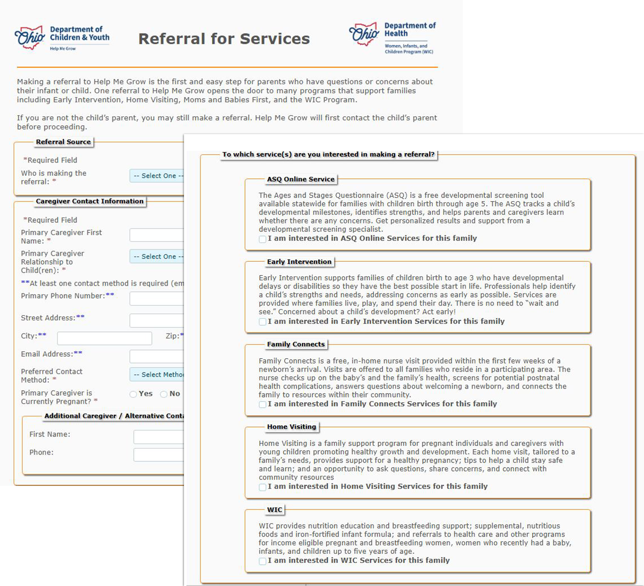
Web referral form
Notes:
The web referral form makes it easy to connect families to all the services we discussed today + WIC (Woman and Children) services.
A Help Me Grow staff member will contact the primary caregiver within the next business day to confirm interest in services.

Slide 19

Thank You!
Notes:
Now that you have learned more about Help Me Grow’s system of support and referral process, hopefully you are ready to refer and are more comfortable with the process. Remember, when you refer a family or child through Help Me Grow, you do not need to know what program for which a family might be eligible. Just refer! Don’t wait and see!

